Slide 1
Third-Party APIs
Module 05

Slide 2
What languages do we use to build web apps?

Slide 3



The Languages of the Web
We use HTML for content and structure, CSS for styling and layout, and JavaScript for handling logic, interaction, and fetching data.
HTML | CSS | JavaScript
Used to write content. | Used to format content. | Used to create dynamic web applications that take in user inputs, change what’s displayed to users, animate elements, and much more.

Slide 4
How do we interact with HTML and CSS using JavaScript?

Slide 5
The DOM Web API
The document object model interface enables developers to interact with the application’s HTML and CSS using JavaScript.
Document
Root element <html>
Element <head>
Element <body>
Element <title>
Attribute “href”
Element <a>
Element <h1>
Text “My title”
Text “My link”
Text “My header”

Slide 6
The DOM Web API
Some of these interactions include the following:
Creating HTML elements.
Changing HTML content and attributes.
Binding listeners to execute a function upon a certain event.

Slide 7
Is the DOM built into the
JavaScript language?

Slide 8
Nope. The browser provides it!

Slide 9
JavaScript and APIs
API
(HTML or XML Page)
=
DOM
+
JS
JavaScript

Slide 10

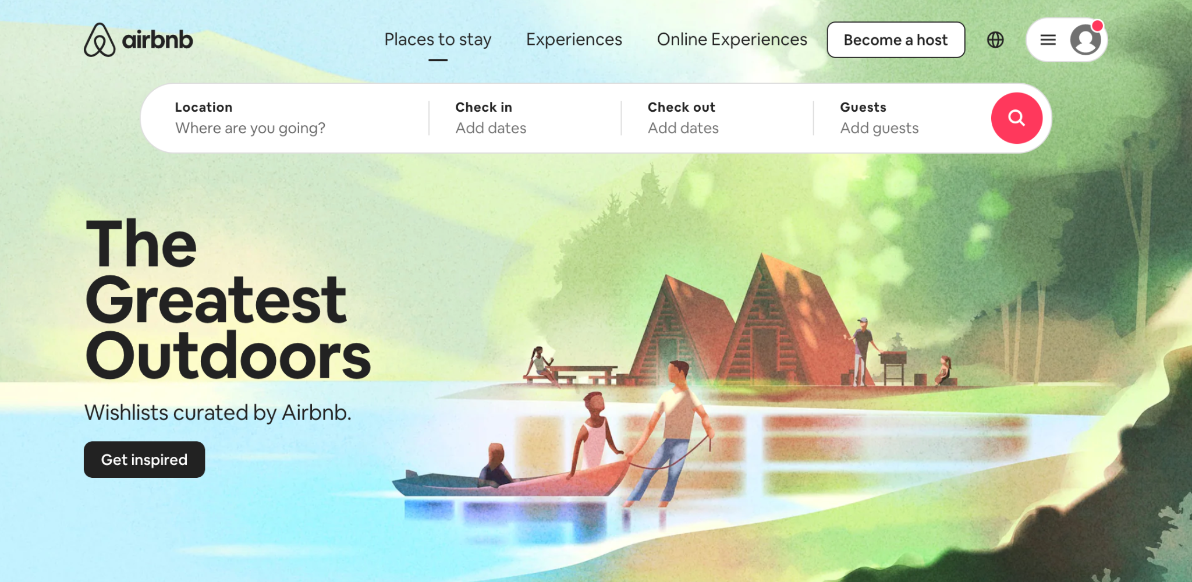
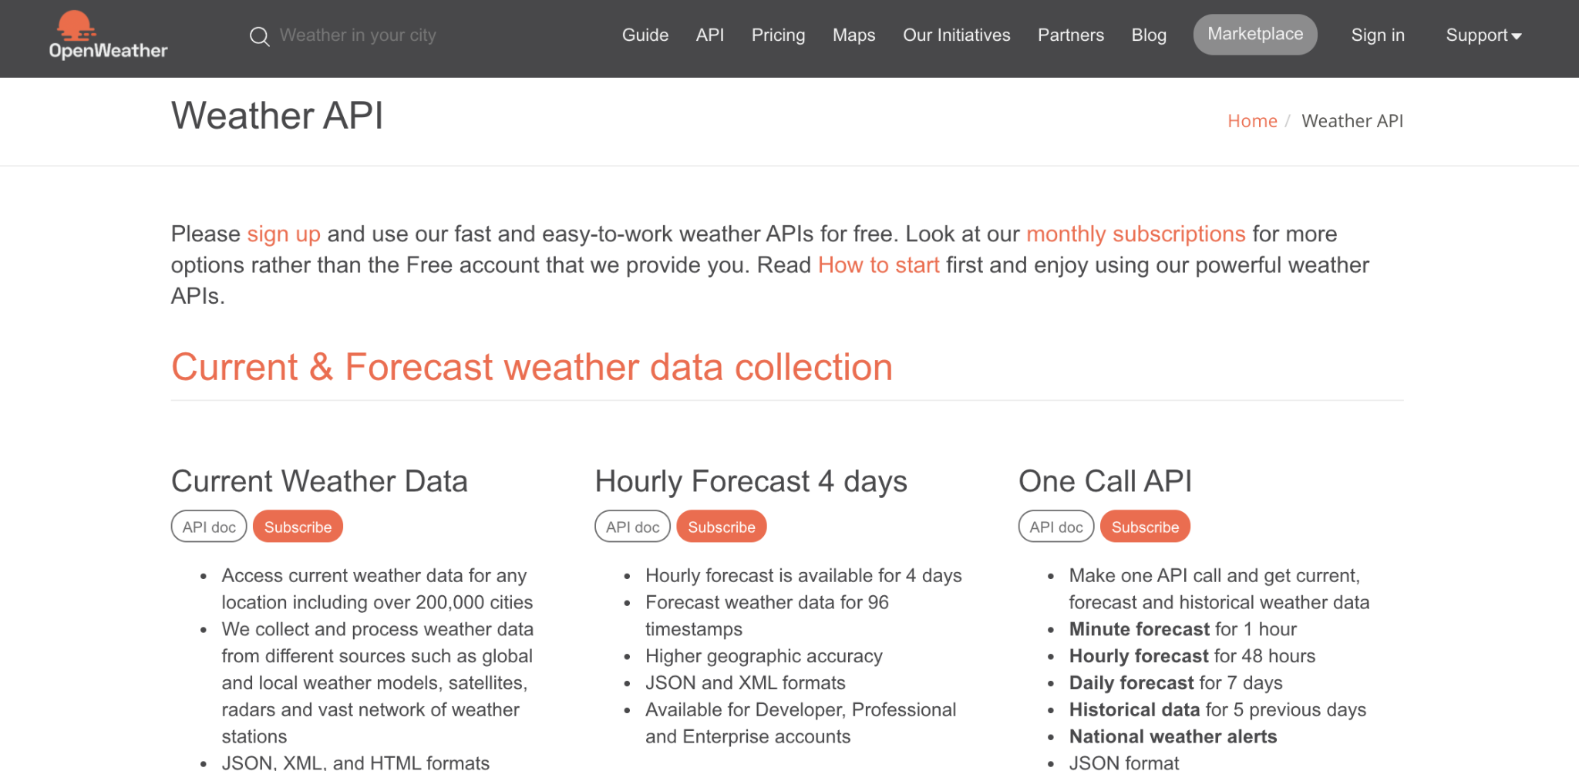
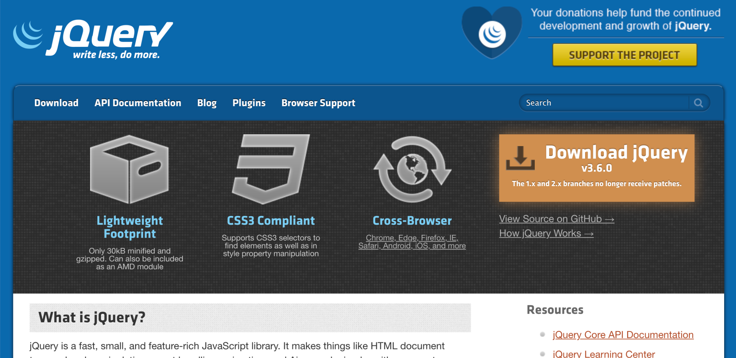
JavaScript and APIs
On its own, JavaScript is very limited. Luckily, the browser provides numerous application programming interfaces (APIs) that we can use in JavaScript code.
AirBNB uses Google’s API for maps
Google Searches for weather uses the Weather API
Even jQuery is an API

Slide 11
JavaScript and APIs
Browser-based APIs we’ve used include the following:
The DOM to interact with our HTML and CSS.
The console to help us debug and print messages.
Timer functions with setTimeout and setInterval.

Slide 12
Are there APIs we can use that
aren’t provided by the browser?

Slide 13
Yes, there are! The web is filled with tools that other developers have built and made available for us to use in our projects!

Slide 14


Third-party APIs
These third-party APIs exist to help us carry out specific tasks that we can do ourselves with CSS or JavaScript but that might be too complex or time-consuming to do by hand.
script.js
$
$
$
$
$
$

Slide 15
Third-party APIs
These APIs can help us in the following ways:
Reduce JavaScript code for DOM manipulation.
Set up a styled and laid-out webpage quickly with premade CSS.
Carry out tedious tasks like converting time or currency values.

Slide 16
How can we learn to use and
implement these APIs?

Slide 17
How to Learn Third-Party APIs
Because these APIs are provided by developers (like us!) of all different backgrounds, there is no one correct way to learn how to use them. What’s important is that you identify what problem an API solves for you and how to properly integrate it into your existing application.
Problem
Solution
$
$
$

Slide 18
How to Learn Third-Party APIs
You can try the following strategies to learn more about specific APIs:
Read the official documentation and practice with the provided examples.
Reverse-engineer finished code to see how something was accomplished.
Build something from scratch.
Debug a broken app using Chrome DevTools.
And most importantly, ask questions!

Slide 19
Mini Project

